Slide 1

Team Astra_11

Slide 2

Problem Statement
SIH 1279:
Development of software for streamlining the listing of cases through Differentiated Case Flow Management
Aim
To develop an AI-integrated middleware solution focused on prioritizing and optimizing case scheduling through a Differentiated Case Flow Management System. This solution should seamlessly integrate into the existing e-court web portal of the Indian Judiciary.

Slide 3








Team Astra_11
Neeraj Kumar
Mitesh Tank
Team Leader
Team Member
Abhishek Pawar
Shwetas Dhake
Team Member
Team Member
Meet Our Team
Prasad Lokhande
Tanvi Pednekar
Team Member
Team Member
--- Mentors ---
Nauman Chohan
Neha Hajare
Industry Mentor
Academic Mentor

Slide 4



PS Code: SIH1279
Our Product

Slide 5






5
Milestone
Index
Problem
Objectives
Proposed
Solution
Intro
Web flow
Diagrams
Future plan
“NyayaSarathi”
Business Model
Social Impact
Conclusion

Slide 6
1) Implementation of DCFM system
2) Efficient Case Prioritization
To use technology to handle administrative difficulties, freeing up time for judges and assisting in prompt case listing, resulting in faster case disposition
Effectively prioritize cases, decreasing dependency on chronological sequence and ensuring cases flow quickly through the system.
Objectives
3) Integration with the existing system
4) Case Disposal Time Reduction
Efficiently and seamlessly integrate the innovative software solution with the existing e-court system, ensuring enhanced functionality
Reduce and estimate the time gap between distinct case occurrences, consequently accelerating the total case disposal process.

Slide 7



Proposed Solution
Case E-Filing System
Upon a legal case registration, generation of an e-file, enabling swift documentation and organized record creation for the case
AI Based Case Prioritization
Efficiently manage cases with a centralized dashboard and prioritization of cases done using AI/ML Model
Judicial Override
Granting judges the authority to modify scheduled case orders, ensuring flexibility and fairness in exceptional circumstances.

Slide 8

1
Lawyer / Litigant
Role: These two users can file cases online through the portal
2
Court Admin
Role: The court admin can view all the registered cases and has the authority to initialise the Scheduling Process
Our
Users
3
Court Judge
Role: Supreme Judge with authority to review and adjust case priorities, thus changing the order

Slide 9
DCFM Process
Priority Assignment
Rescheduling of cases
AI-based model assigns case priority considering complexity, duration, urgency, nature, and party's age.
The judge can change the severity of cases, affecting the order in which streamlined proceedings are handled.
1
STEP 2
2
3
STEP 4
4
STEP 1
STEP 3
MAY
Case E-Filing
Streamlining of cases
Lawyer/Litigant files case online through the centralized dashboard
Efficiently streamline cases with the Multi-Level Queue Algorithm, dynamically adjusting priorities for fair scheduling.

Slide 10
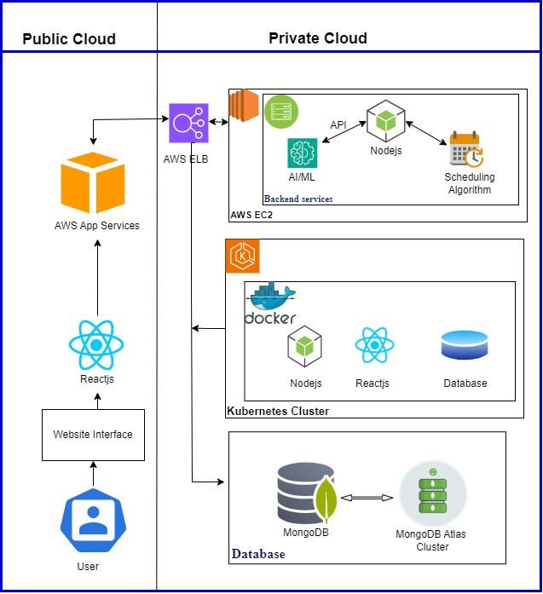
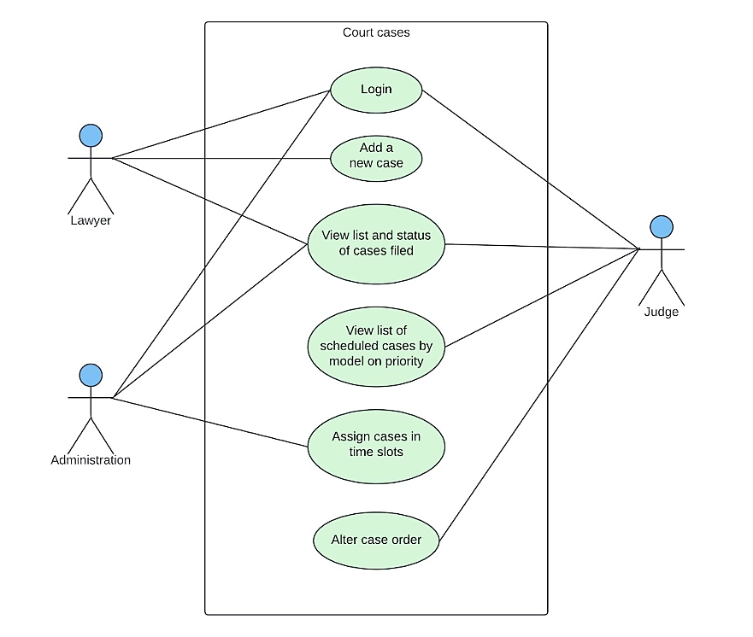
Use Case Diagram
System Architecture

Slide 11
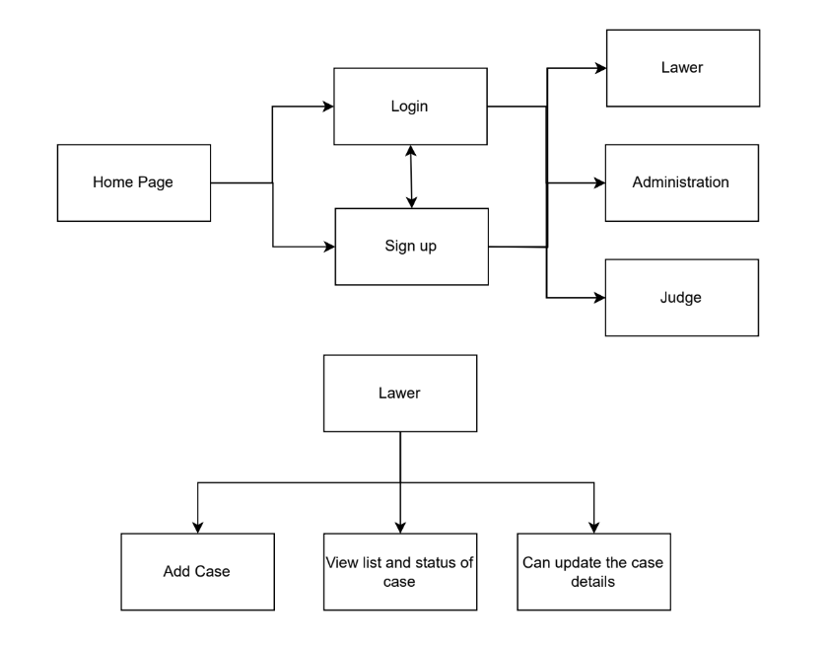
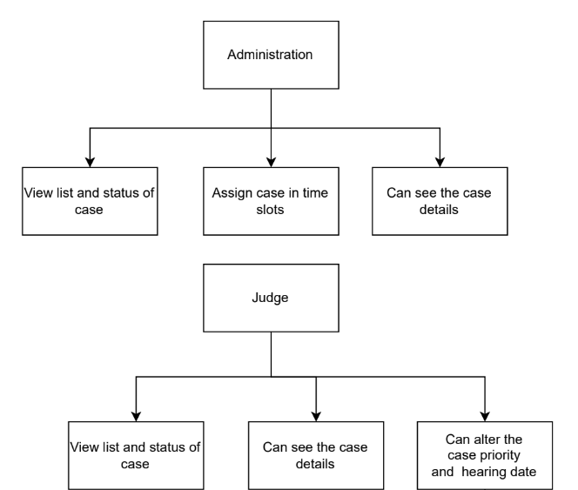
Website Flow Diagram

Slide 12
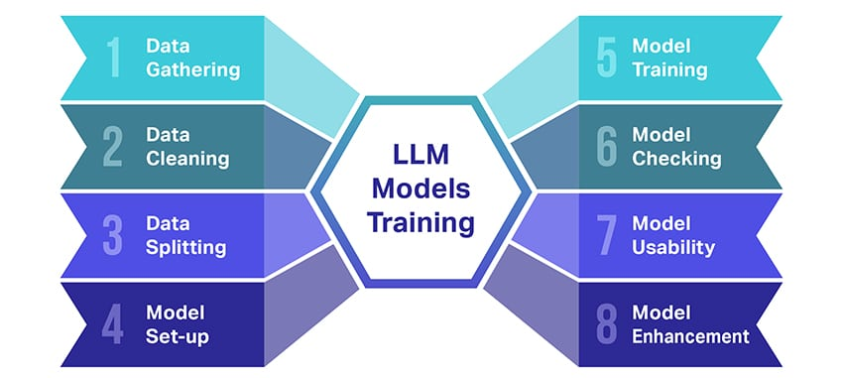
AI/ML Model
The prioritization of registered cases involves utilizing an ML model developed with the LLM Model. This model is trained using comprehensive datasets that encompass all Indian Penal codes and laws, followed by fine-tuning process.
AI based Prioritization model
Complexity
Urgency
Party’s Age
Nature of Offence
1
8
5
3
2
1
Prioritized cases

Slide 13

MLQ Algorithm
The registered cases are sorted in three separate queues: urgent, moderate and low. A certain number of cases from each queue is taken and one set of cases is formed, this pattern keeps on repeating until all cases are scheduled. This ensures that the cases with low priority are not ignored and all cases are scheduled fairly.
Moderate Priority
Urgent Priority
Low Priority
This category has the maximum no. of cases in a set
This category has moderate no. of cases in a set
This category has the minimum no. of cases in a set

Slide 14



Deployment
Docker
Kubernetes (K8s)
AWS
We leverage Docker technology for the purpose of containerization and the creation of images. Docker plays a pivotal role in our project by providing a platform that facilitates the seamless packaging, deployment, and scaling of applications in isolated containers.
Kubernetes for seamless container orchestration and automated scaling. We can efficiently manage deployments, optimize resource utilization, and foster a modular, easily maintainable architecture, enhancing the overall reliability and efficiency of our system.
Initially, for testing purposes, our project is hosted on AWS. As we progress, we've containerized it, and AWS serves as a reliable backup deployment option, ensuring flexibility and redundancy in our deployment strategy.

Slide 15
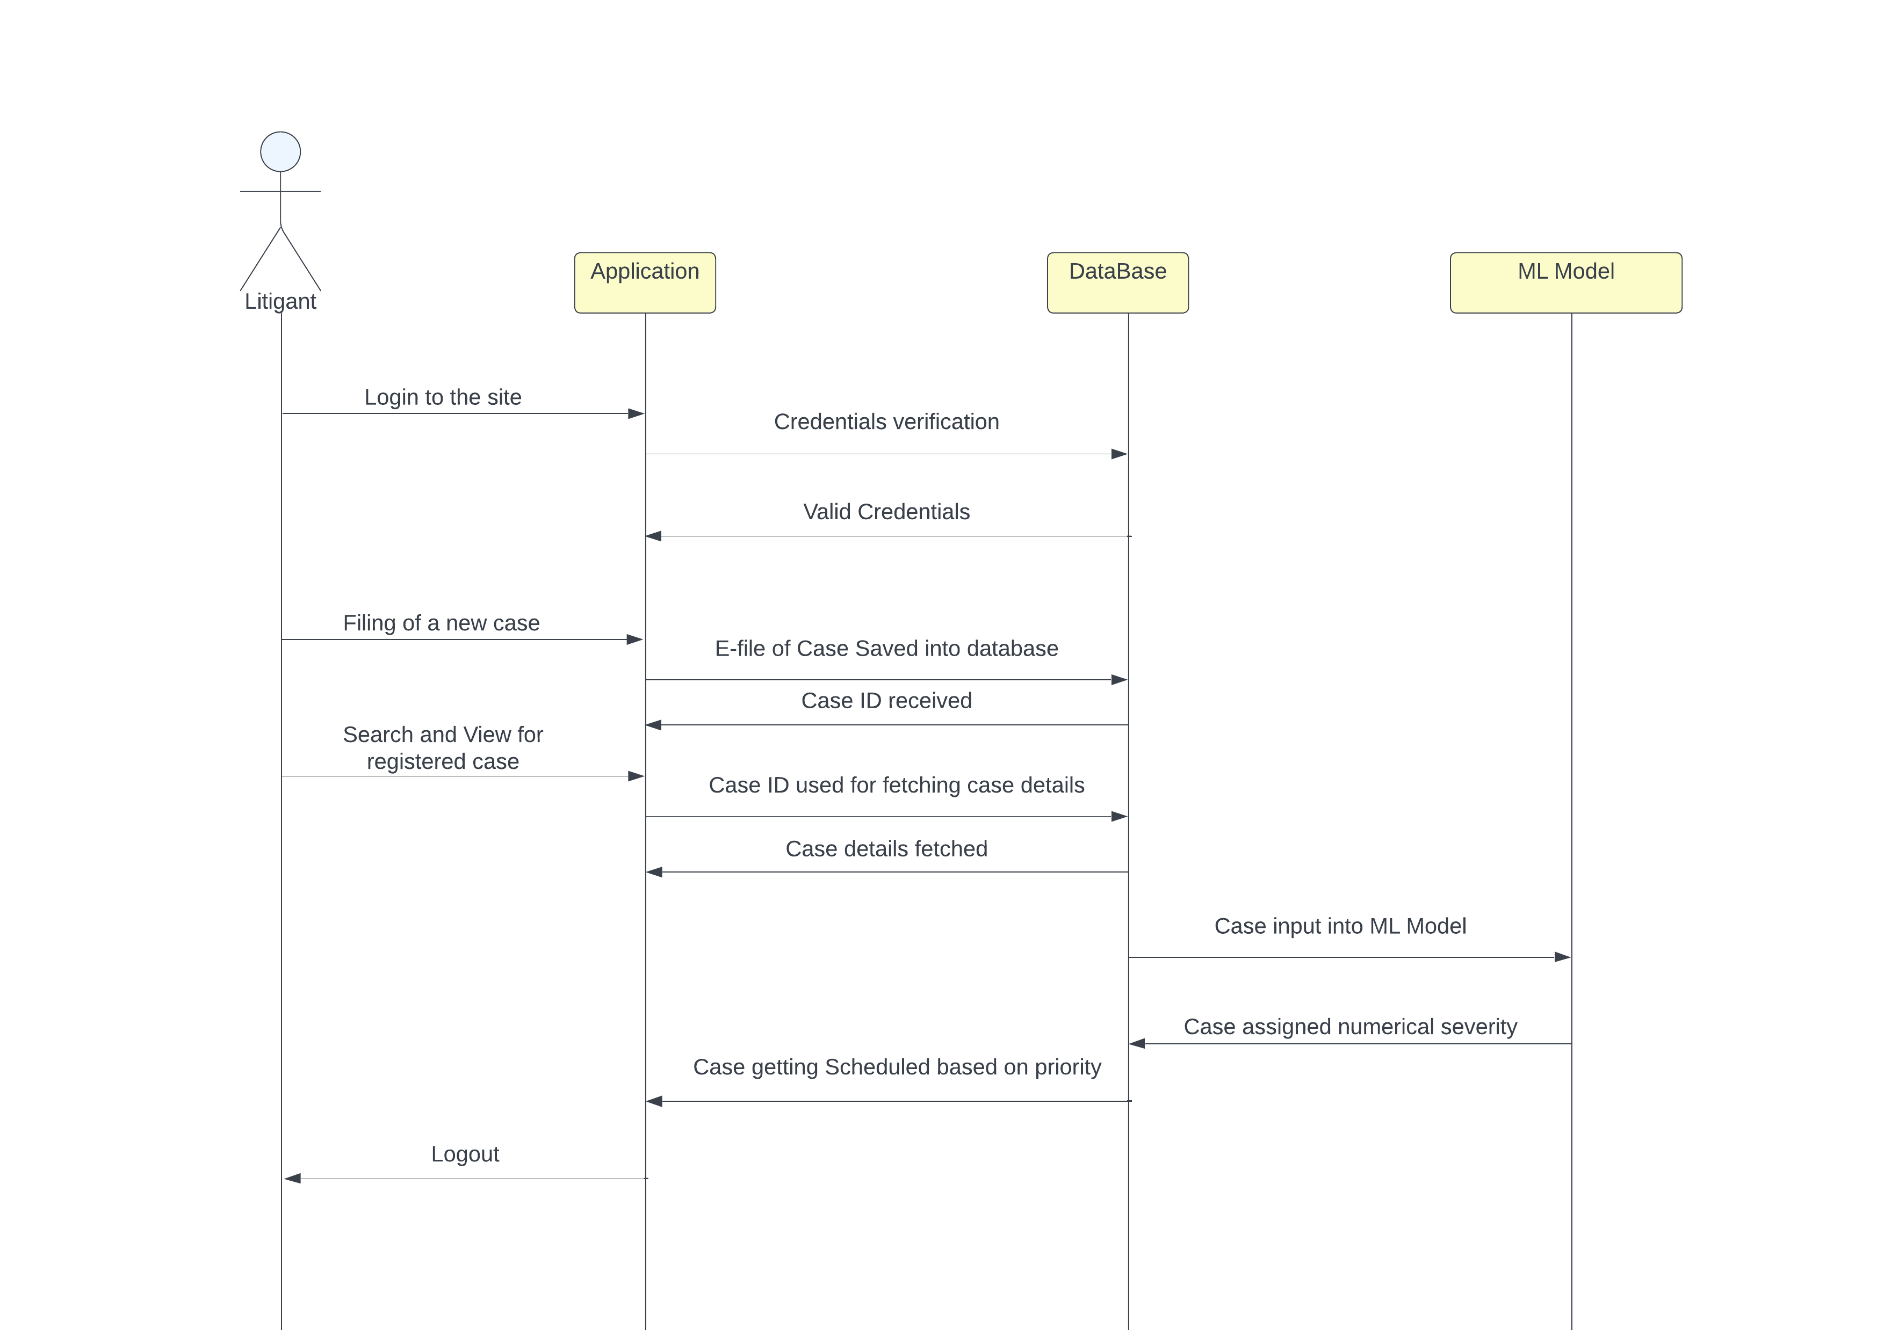
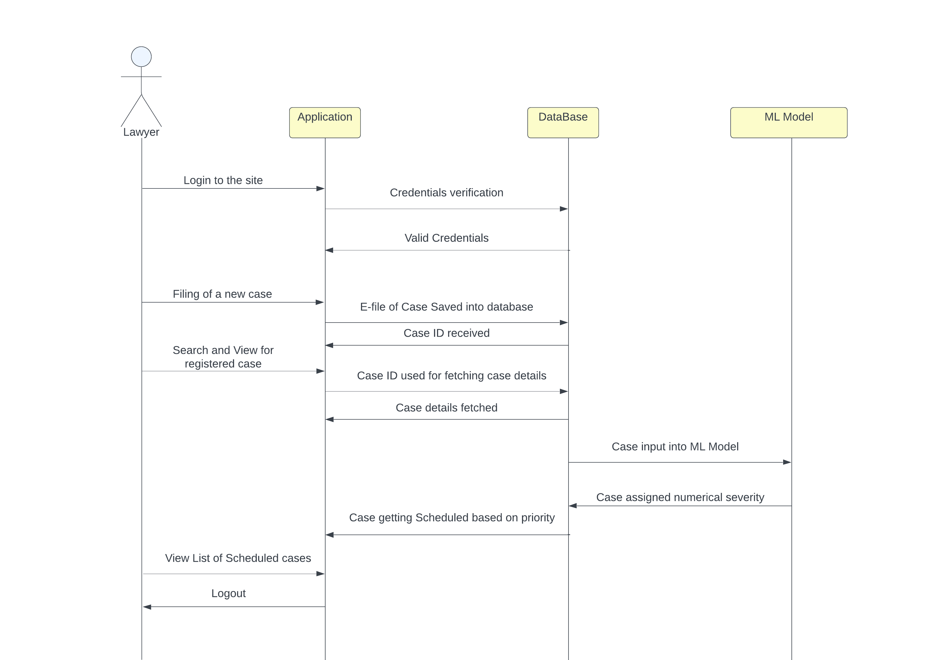
Sequence Diagram

Slide 16
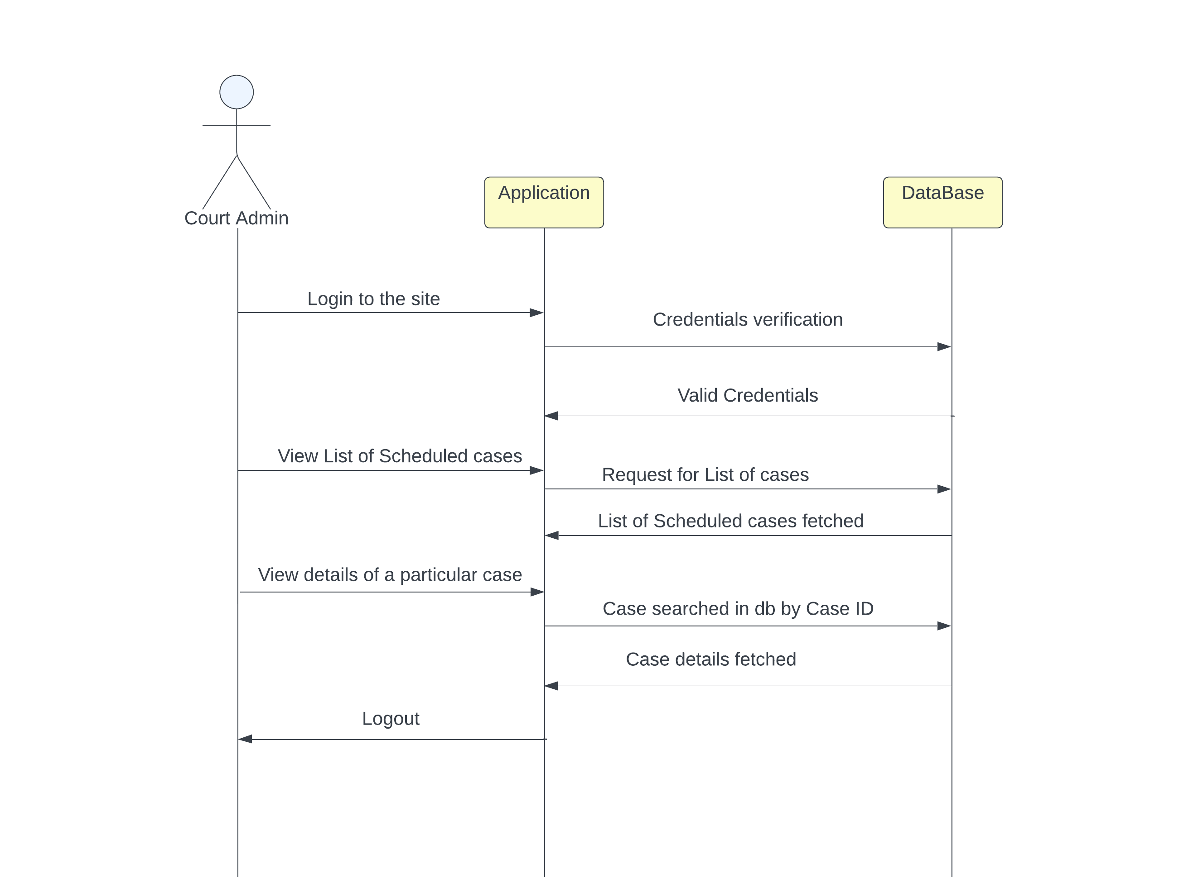
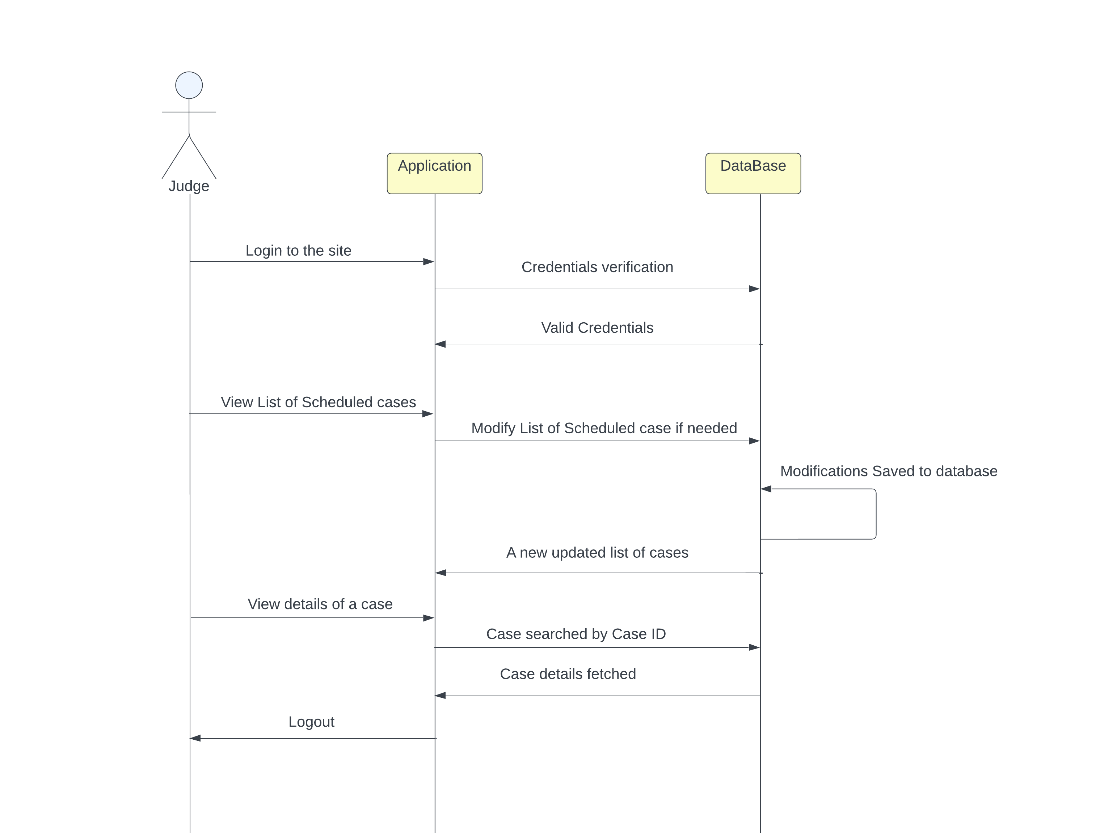
Sequence Diagram

Slide 17
Dedicated AI Law Assistant
01
Introducing our Dedicated AI Law Assistant – a specialized chatbot tailored for legal needs, offering precise legal insights and research assistance to streamline workflows and support legal professionals.
Multi-lingual Support
Our product boasts multi-lingual support, ensuring accessibility for users in diverse languages. This feature enhances user experience and extends the reach of our product to a global audience.
02
FuturePlan
Deployment and Scaling
03
Container orchestration using Kubernetes and deployment on AWS EKS
Upgrade MLQ Algorithm to MLFQ
03
To upgrade our MLQ Scheduling Algorithm to MLFQ (Multi-Level Feedback Queue) for better scheduling and including the Aging Process.

Slide 18


Business Model
“ Flexible Subscription plan based on law firms requirement and No fee for Government. “
Pay per
cases
PaaS
For Courts
SaaS for law firms.

Slide 19
19
Conclusion
Summarizing it all, Differentiated Case Flow Management (DCM) will reduce waiting times between case events, making the process more predictable and efficient for quicker case disposal. Additionally, the use of the MLF algorithm ensures fairness in managing case priorities, optimizing both short and long processes for better system efficiency.
Together, these advancements promise a transformative improvement in the Indian legal system, enhancing fairness, efficiency, and timely resolution of cases.

